Slide 1
Introduction to Regression Analysis

Slide 2
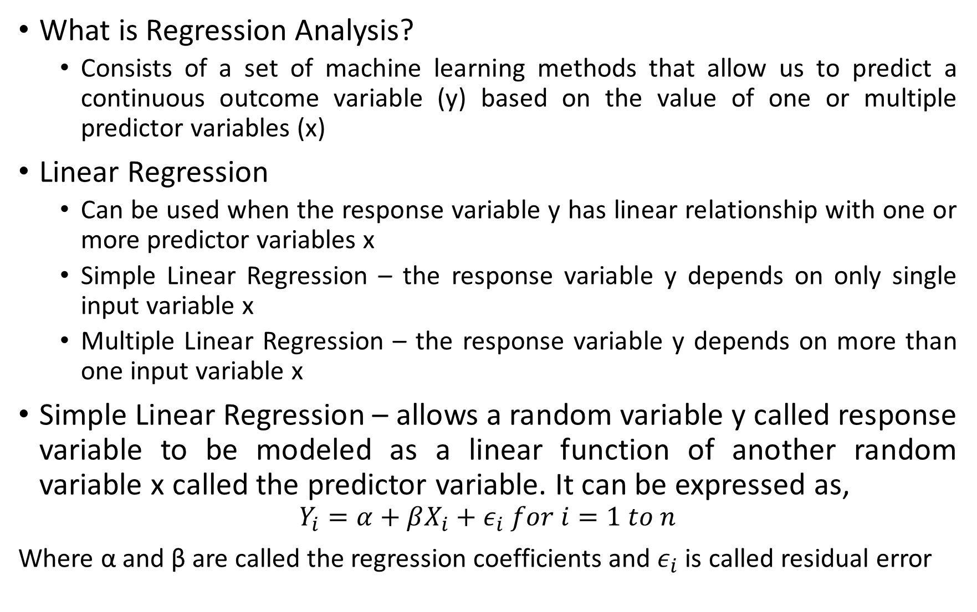
What is Regression Analysis?
Consists of a set of machine learning methods that allow us to predict a continuous outcome variable (y) based on the value of one or multiple predictor variables (x)
Linear Regression
Can be used when the response variable y has linear relationship with one or more predictor variables x
Simple Linear Regression – the response variable y depends on only single input variable x
Multiple Linear Regression – the response variable y depends on more than one input variable x
Simple Linear Regression – allows a random variable y called response variable to be modeled as a linear function of another random variable x called the predictor variable. It can be expressed as,
$$Y_{i}=α+βX_{i}+ε_{i} for i=1 to n$$
Where α and β are called the regression coefficients and $ε_{i}$ is called residual error

Slide 3
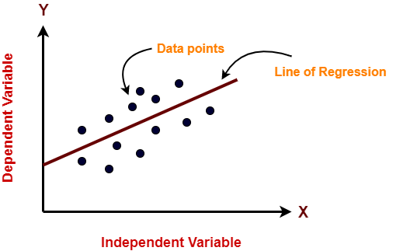
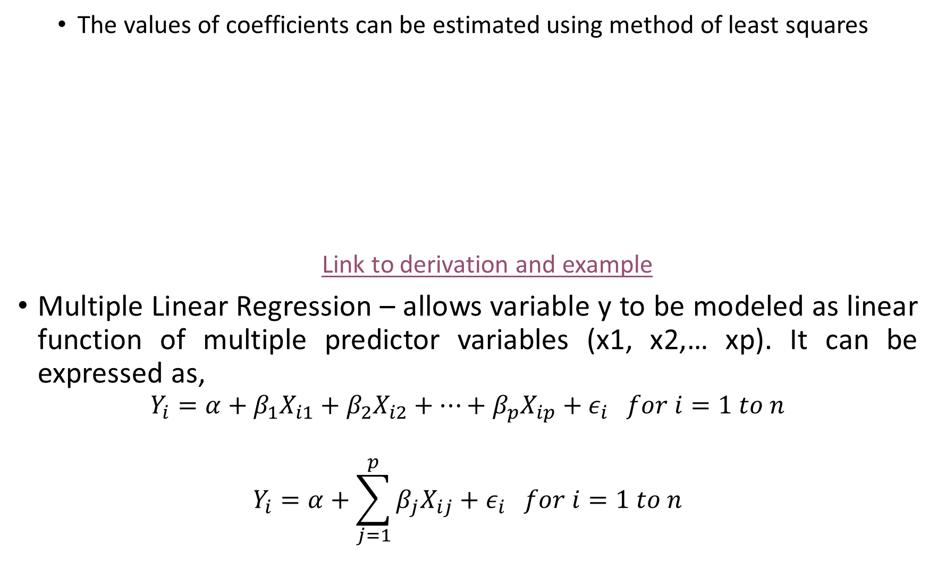
The values of coefficients can be estimated using method of least squares
Link to derivation and example
Multiple Linear Regression – allows variable y to be modeled as linear function of multiple predictor variables (x1, x2,… xp). It can be expressed as,
$$Y_{i}=α+β_{1}X_{i1}+β_{2}X_{i2}+…+β_{p}X_{ip}+ε_{i} for i=1 to n$$
$$Y_{i}=α+\sum_{j=1}^{p}{β_{j}X_{ij}}+ε_{i} for i=1 to n$$

Slide 4
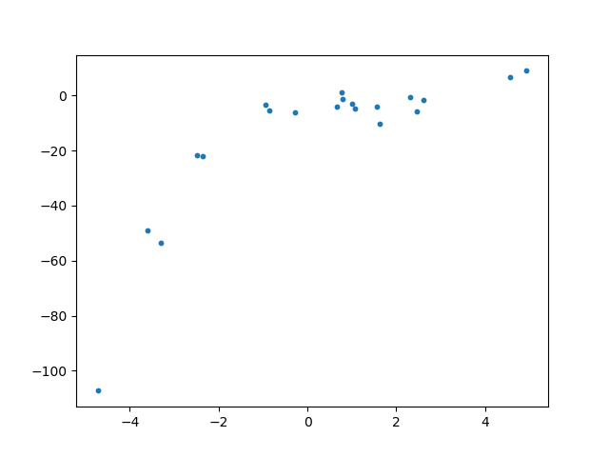
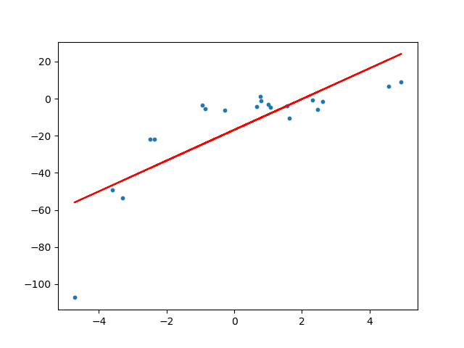
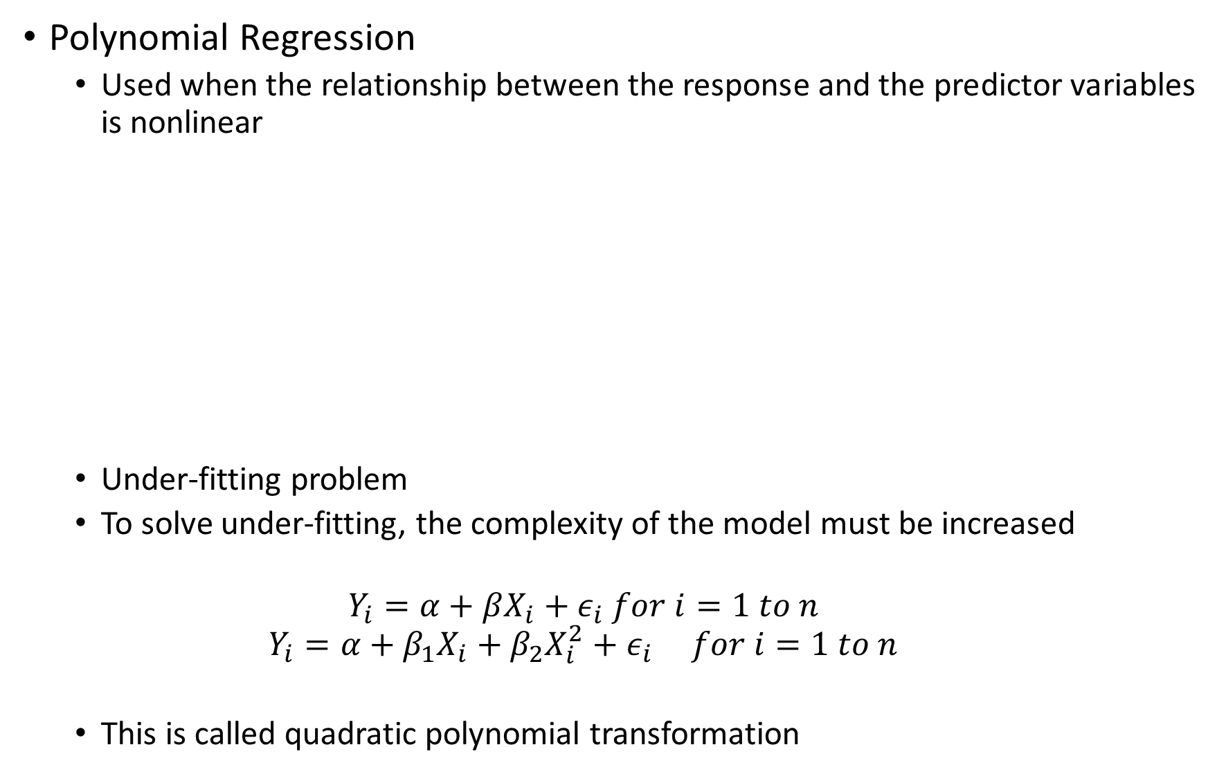
Polynomial Regression
Used when the relationship between the response and the predictor variables is nonlinear
Under-fitting problem
To solve under-fitting, the complexity of the model must be increased
$$Y_{i}=α+βX_{i}+ε_{i} for i=1 to n$$
$$Y_{i}=α+β_{1}X_{i}+β_{2}X_{i}^{2}+ε_{i} for i=1 to n$$
This is called quadratic polynomial transformation

Slide 5
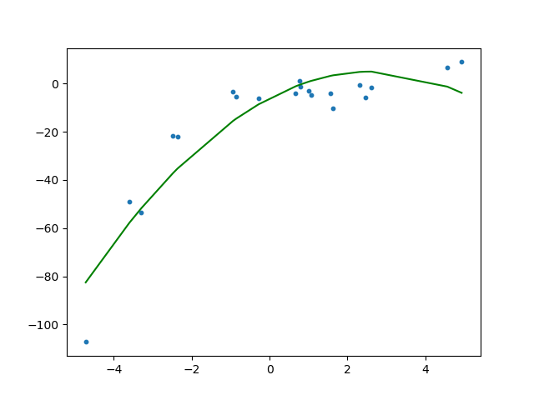
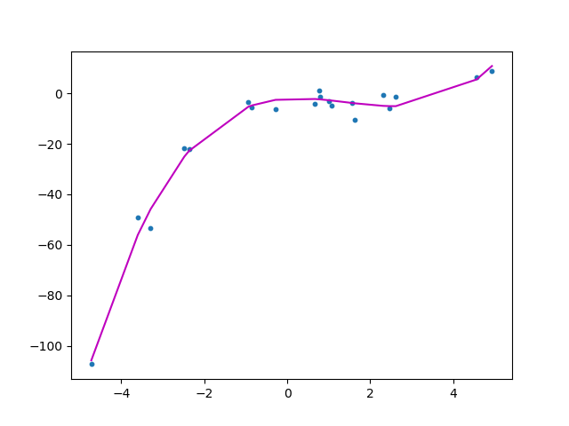
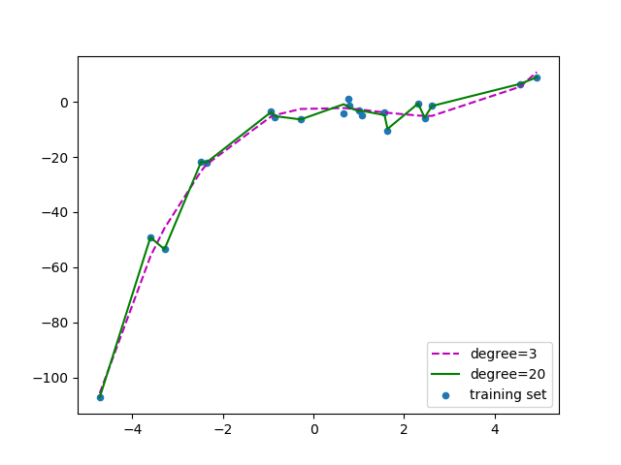
Over-fitting problem
Bias and Variance tradeoff

Slide 6
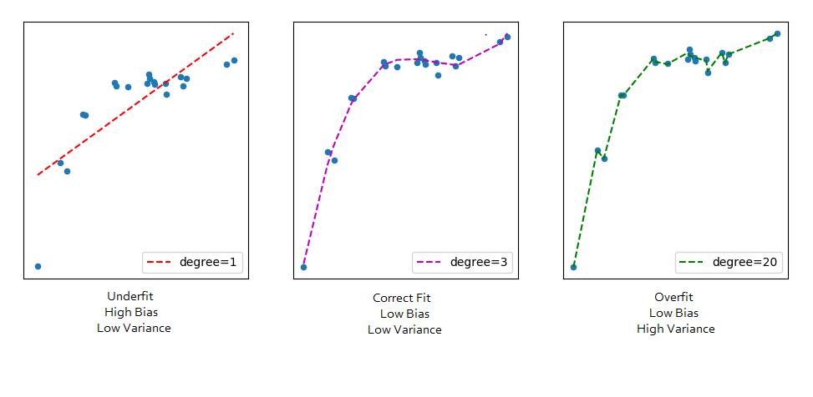
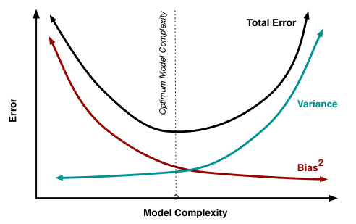
Ideally, a machine learning model should have low variance and low bias.

Slide 7
Stepwise Regression
Used when there is uncertainty about which of a set of predictor variables should be included in a regression model.
There are three strategies of stepwise
Forward selection
Backward elimination
Sequential replacement
Is not stable and not considered as reliable technique
Not included in sklearn
Ridge Regression
Number of predictors > Number of samples OR multicollinearity
Estimated coefficients can become very large which makes the model sensitive to the input & possibly unstable.
Loss function is modified to include penalty for model to have large coefficients

Slide 8
Referred to as penalized linear regression
Model is penalized based on the sum of the squared coefficients known as L2 penalty
L2 penalty minimizes (shrinks) all coefficients without allowing their value to become zero
A hyperparameter, λ (Lamda) with value in the range 0 to 1, is used to control the weight of L2 penalty
So, Ridge loss is given as,
ridge_loss = loss + λ * L2_penalty
LASSO Regression
Another penalized or regularized linear regression
Model is penalized based on the sum of absolute coefficients known as L1 penalty
Allows coefficients to reduce to zero, effectively removing the corresponding predictors that contribute less to the model (automatic feature selection)

Slide 9
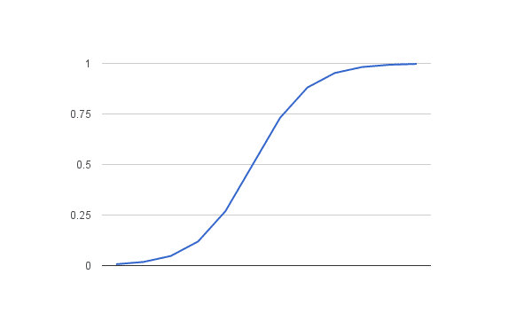
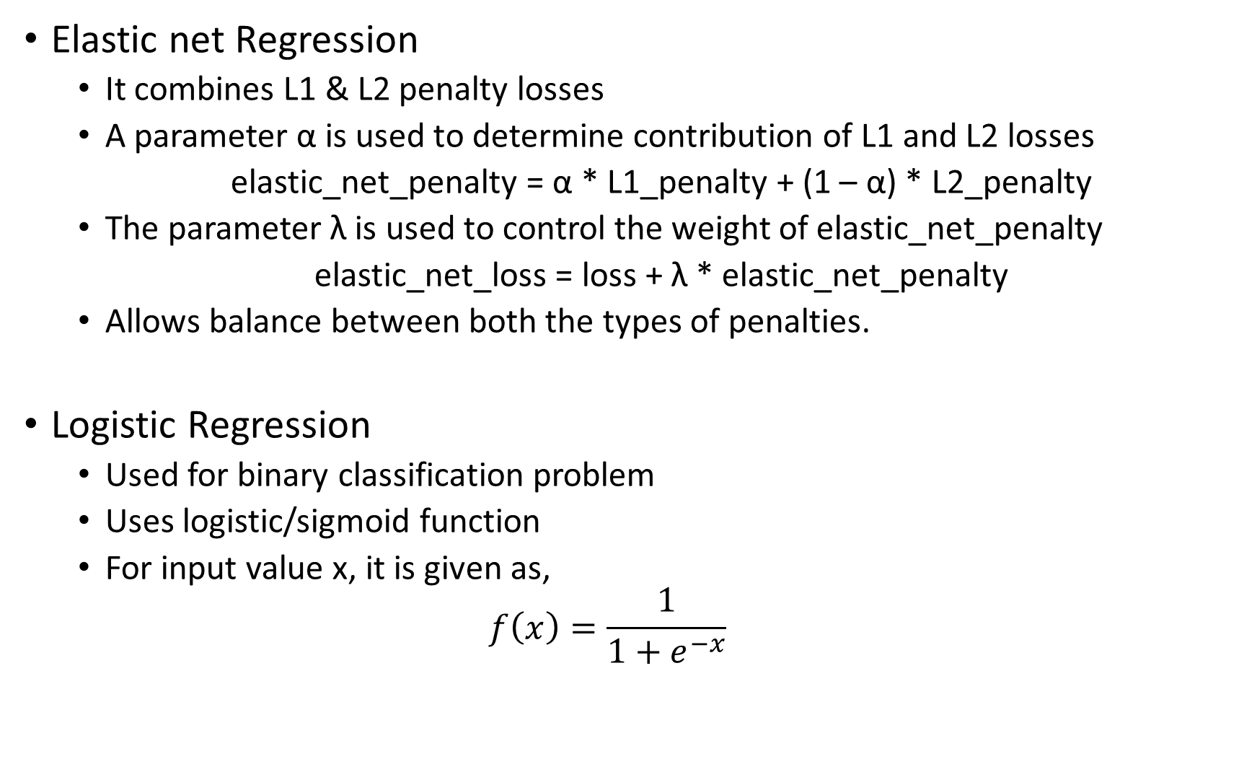
Elastic net Regression
It combines L1 & L2 penalty losses
A parameter α is used to determine contribution of L1 and L2 losses
elastic_net_penalty = α * L1_penalty + (1 – α) * L2_penalty
The parameter λ is used to control the weight of elastic_net_penalty
elastic_net_loss = loss + λ * elastic_net_penalty
Allows balance between both the types of penalties.
Logistic Regression
Used for binary classification problem
Uses logistic/sigmoid function
For input value x, it is given as,
$$f\left(x\right)=\frac{1}{1+e^{−x}}$$

Slide 10
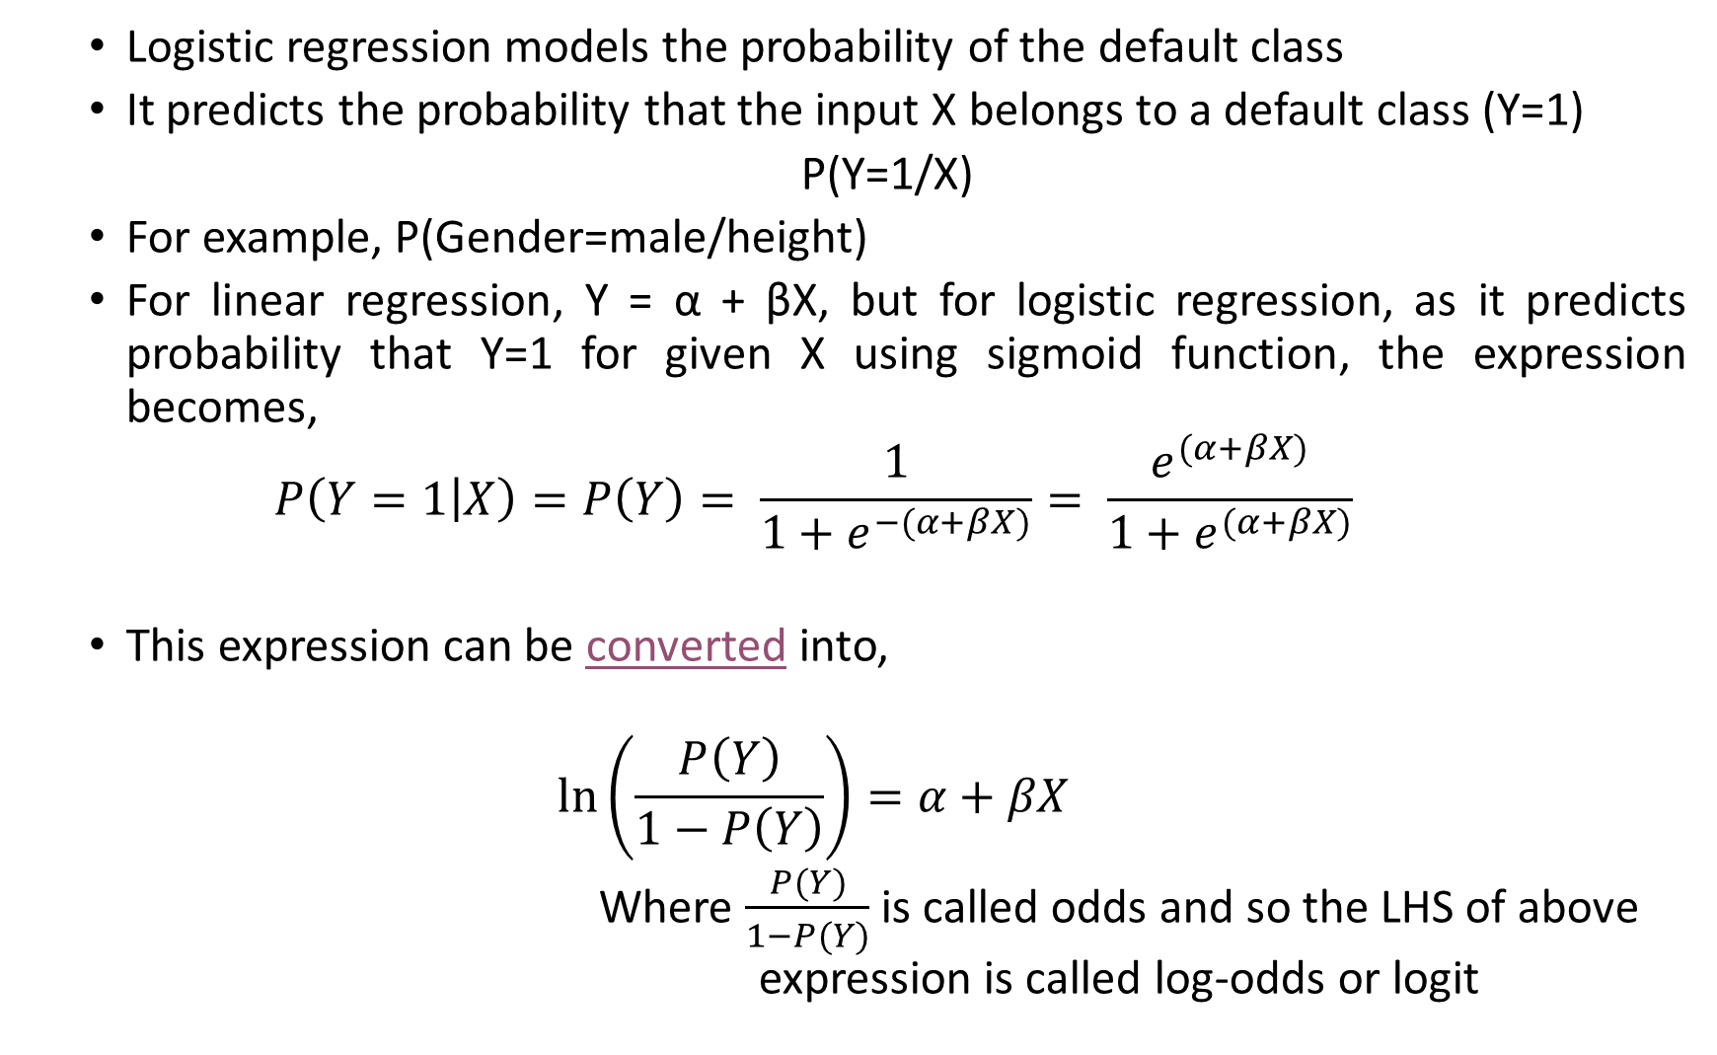
Logistic regression models the probability of the default class
It predicts the probability that the input X belongs to a default class (Y=1)
P(Y=1/X)
For example, P(Gender=male/height)
For linear regression, Y = α + βX, but for logistic regression, as it predicts probability that Y=1 for given X using sigmoid function, the expression becomes,
$$P\left(Y=1 | X\right)=P\left(Y\right)= \frac{1}{1+e^{−(α+βX)}}= \frac{e^{(α+βX)}}{1+e^{(α+βX)}}$$
This expression can be converted into,
$$\ln\left(\frac{P\left(Y\right)}{1−P\left(Y\right)}\right)=α+βX$$
Where $\frac{P(Y)}{1−P(Y)}$ is called odds and so the LHS of above expression is called log-odds or logit

